Slide 1
The Discovery Center
Osmar Coronel & Steven Rodriguez

Slide 2

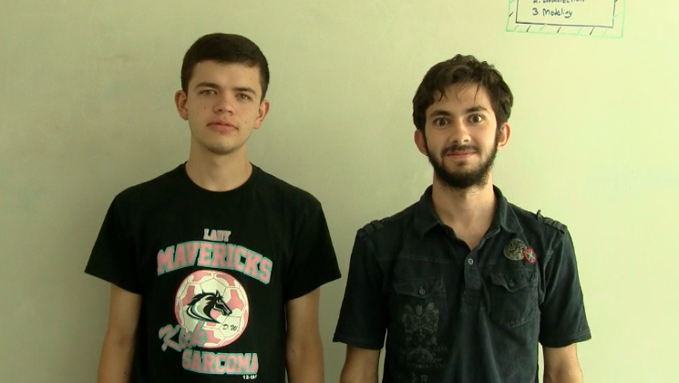
The team
Us two against the odds

Slide 3

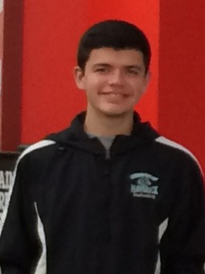
Osmar Coronel
Java Coder
Graphics
Filmer
Editor

Slide 4
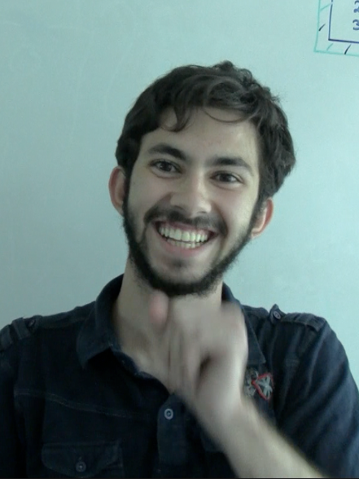
Steven Rodriguez
UI Designer
Project Manager
Writer
Actor

Slide 5
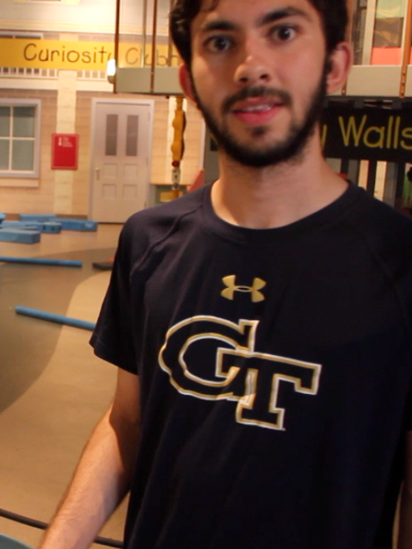
Our preparation
lots of research

Slide 6
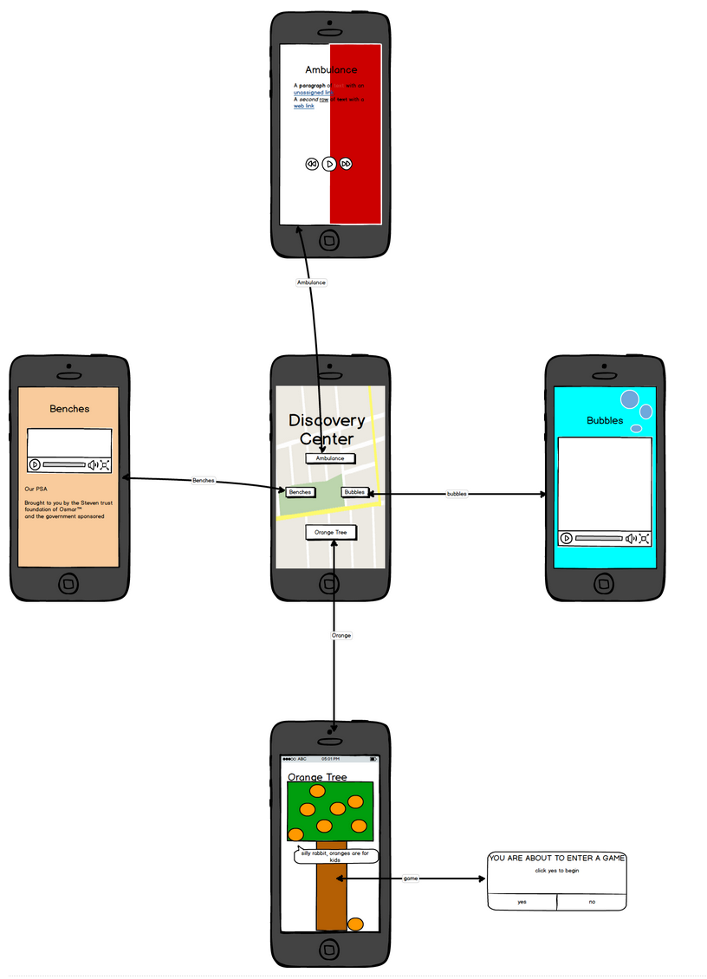
The Outcome

Slide 12


Slide 13
DEMO

Slide 14


Coding
The foundation

Slide 15
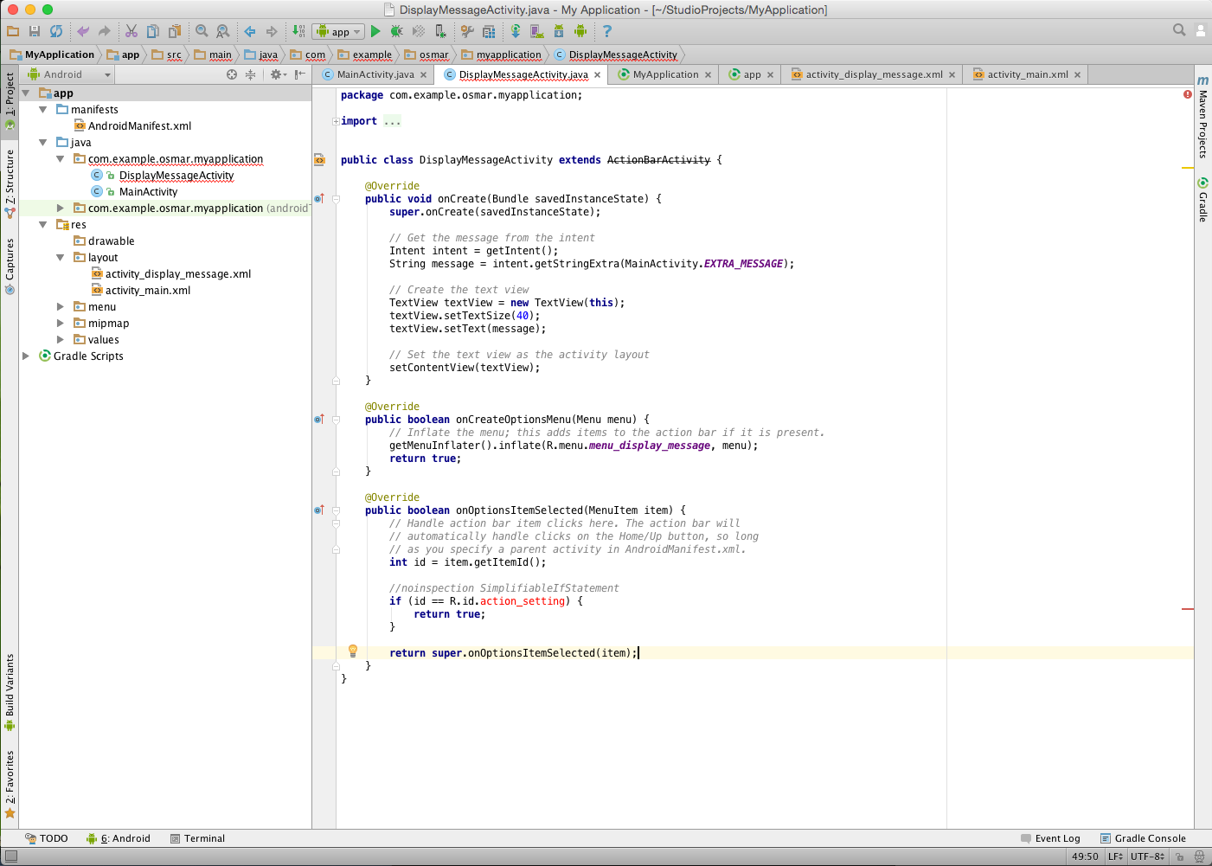

Slide 16
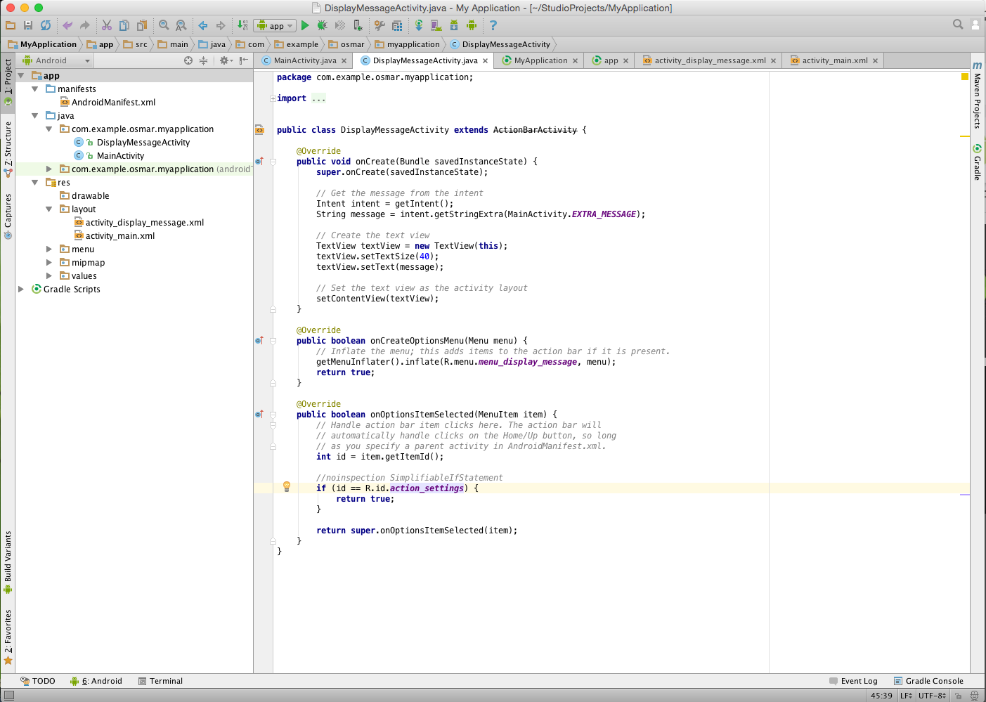

Slide 17
The UI
The experience

Slide 19

The Graphics
The beauty

